Slide 1
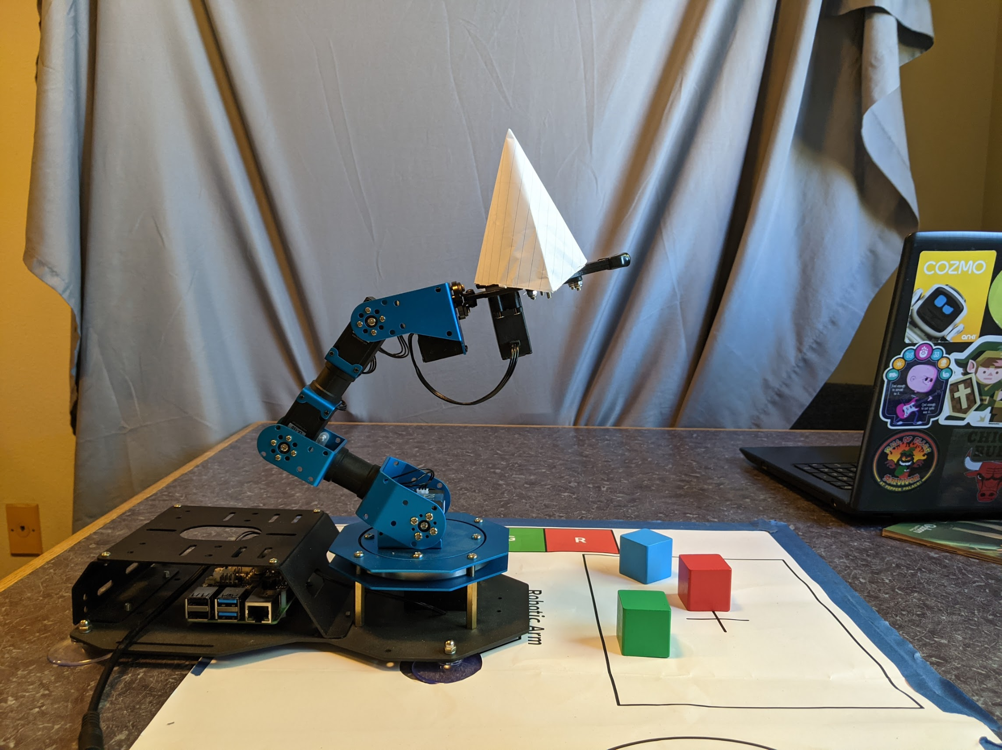
The Stackening
Ryan Quick, Nigel Swenson, Ameer Helmi
ROB521 Final Presentation

Slide 2
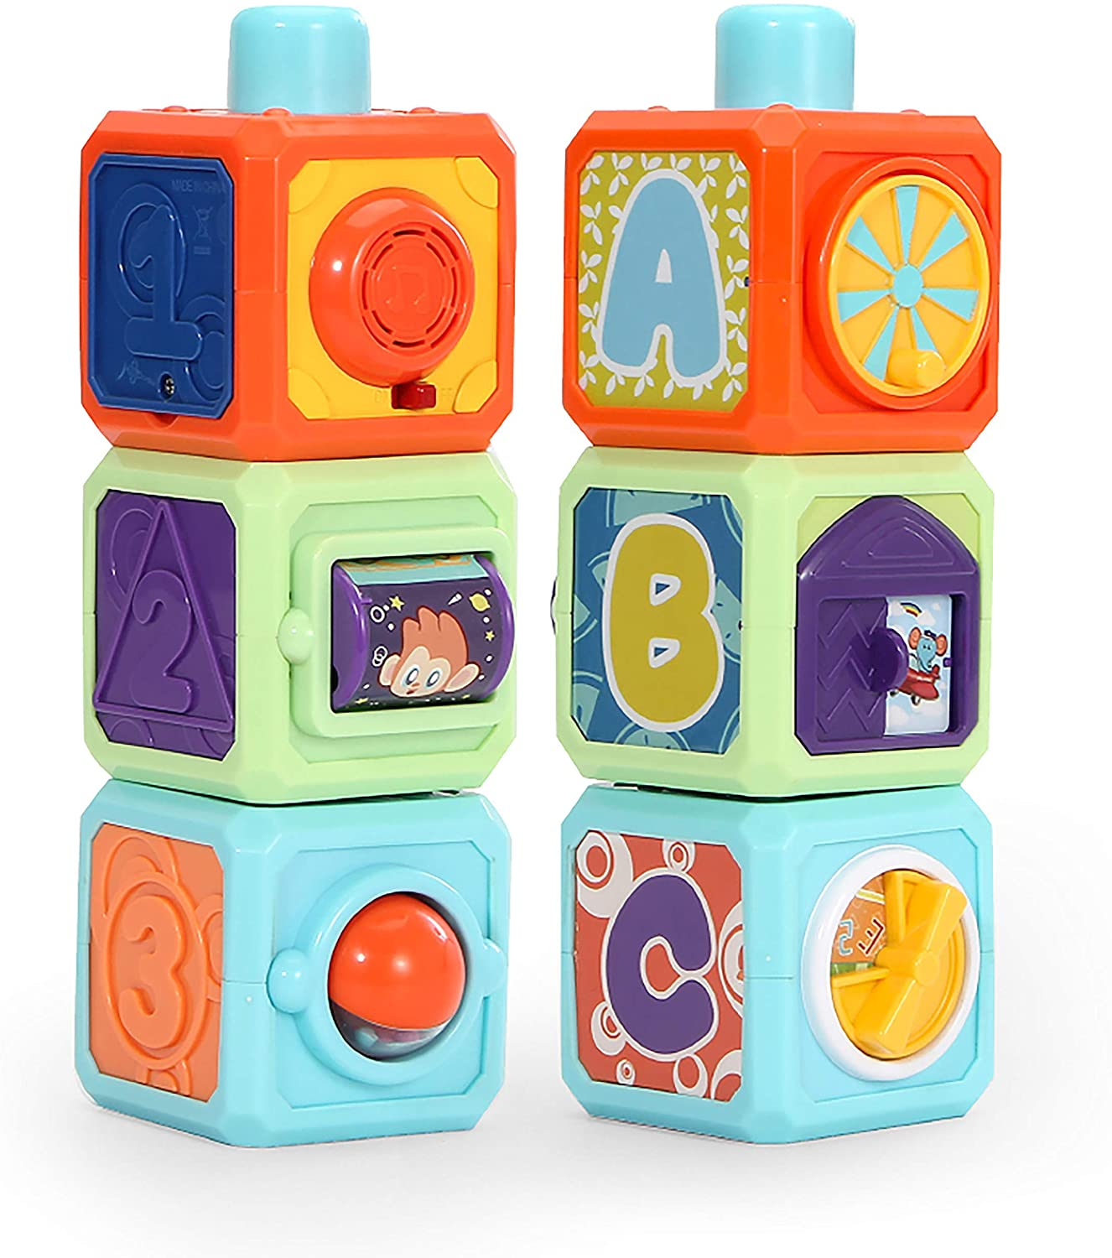
Problem Introduction
Stacking cubes accurately can be a challenge
Need a good grasp on each block and to stack effectively
Fixing a bad stack
Also fun!

Slide 3
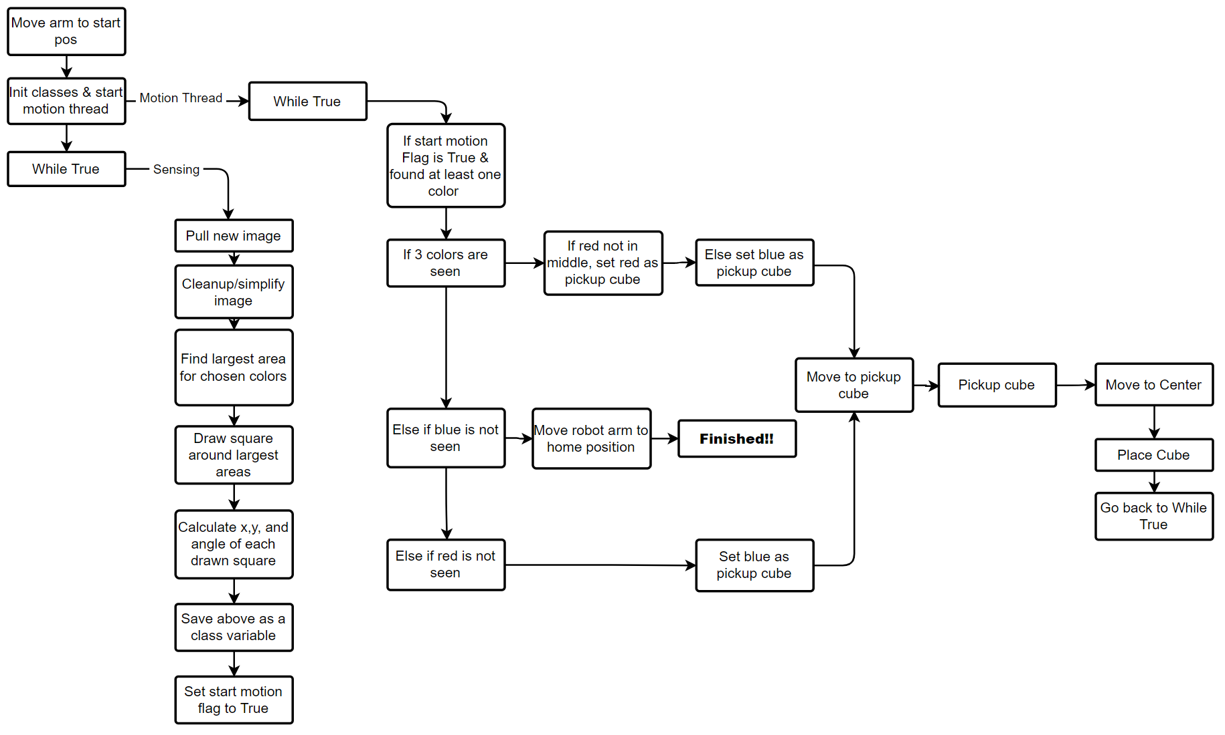

Slide 5
Implementation Issues and Limitations
Lighting variability affected OpenCV
Code made for 1 cube
We wanted information for all 3
X,Y,Z, and Yaw
Code is robust to missing the stack
Not for cubes missing from FOV
OpenCV see lower block in stack
Make wrong decision
Gripper would let go too early

